Slide 1
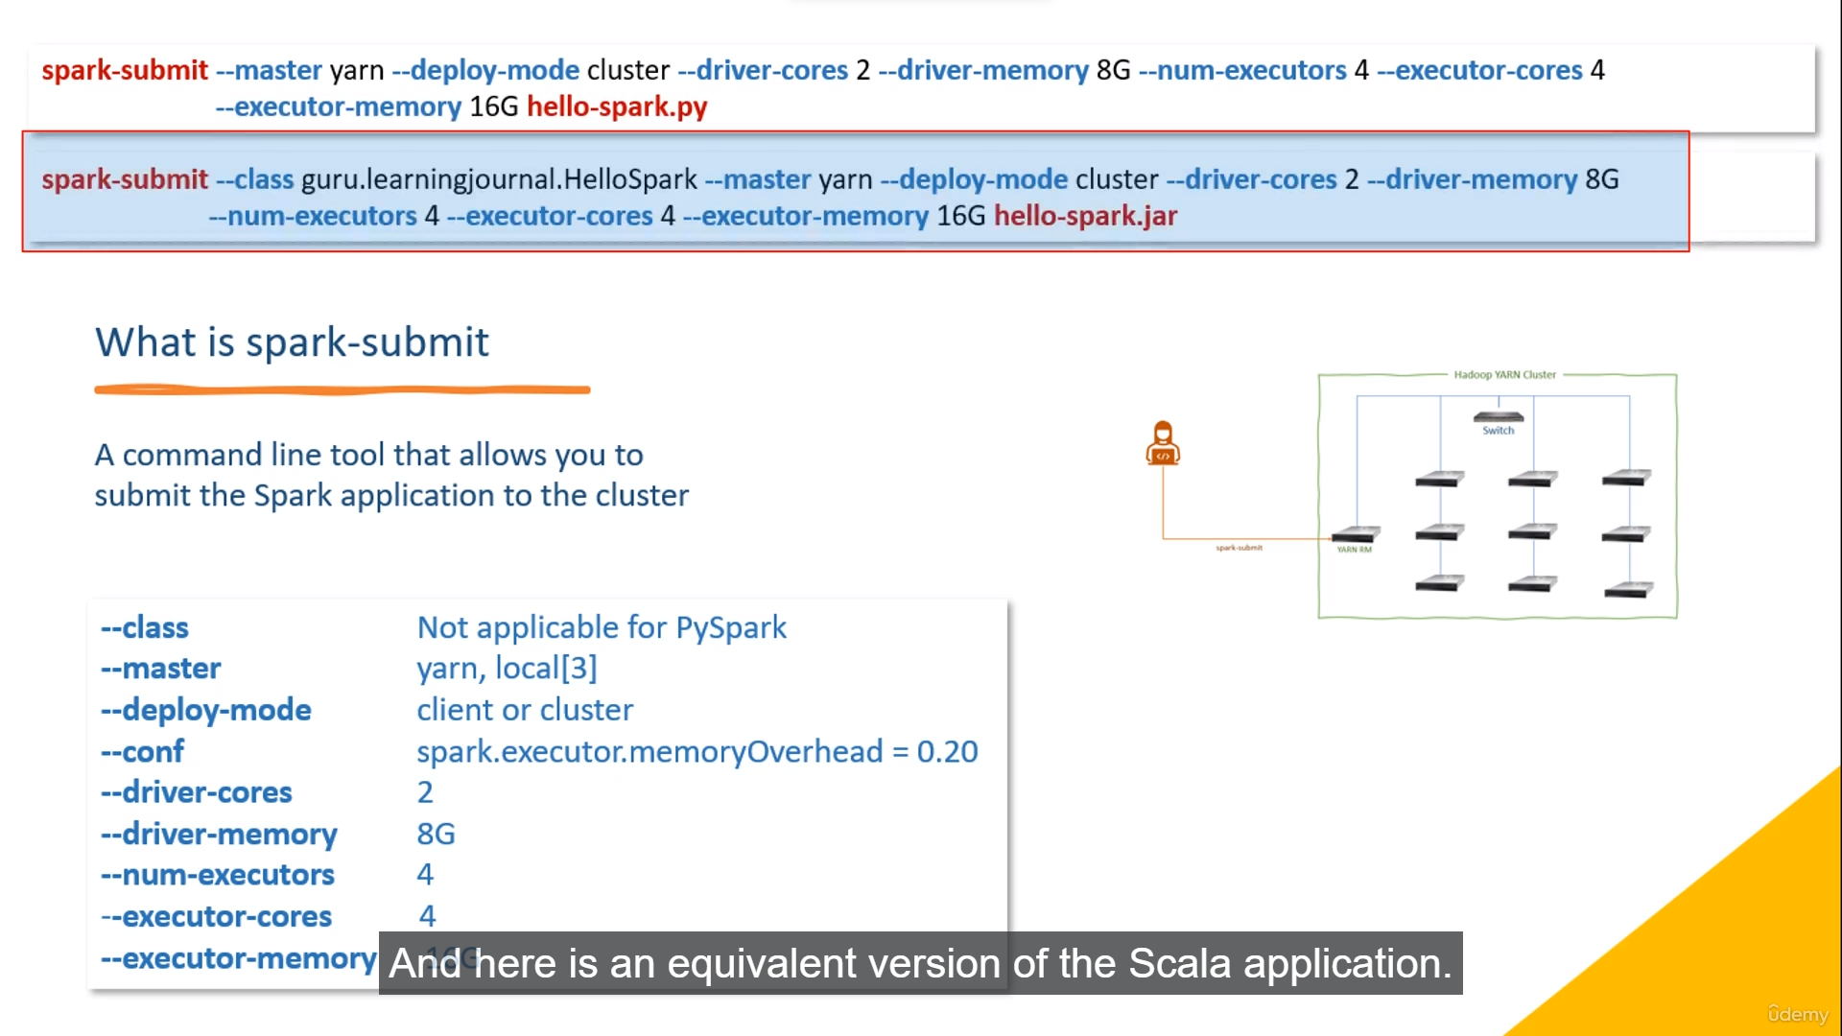

Slide 2
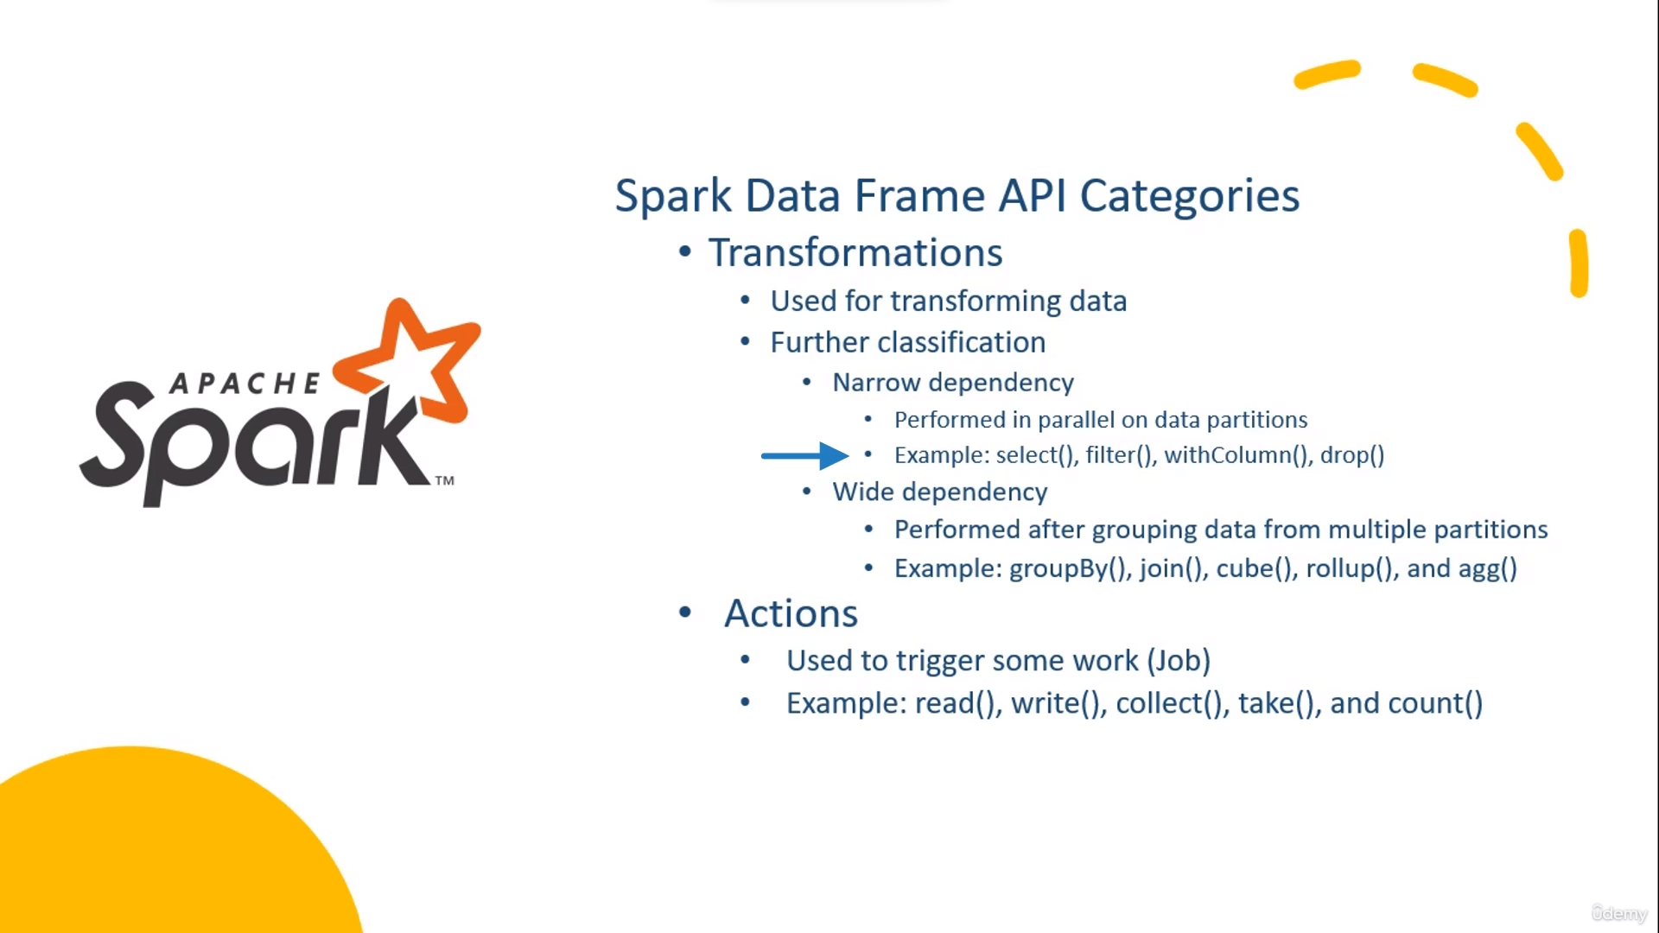

Slide 3
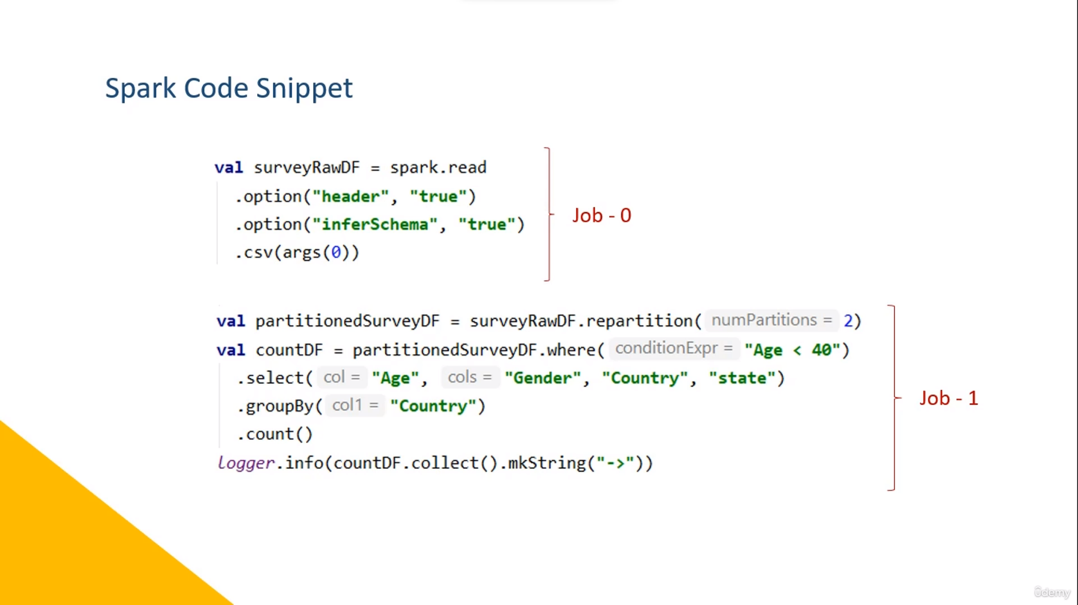

Slide 4
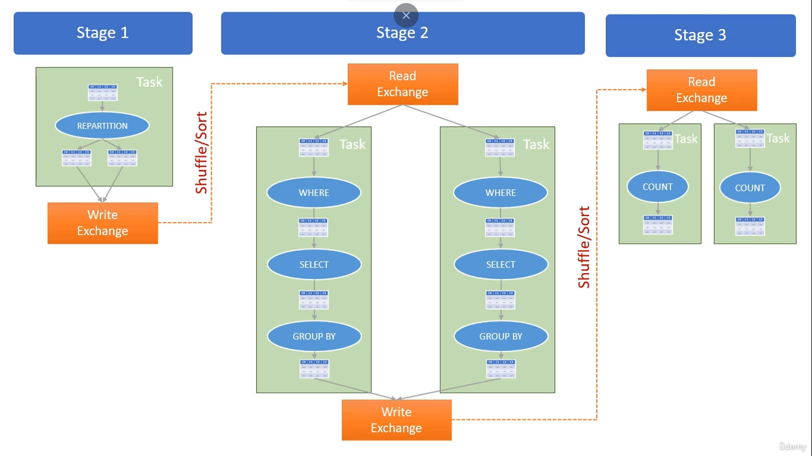

Slide 5
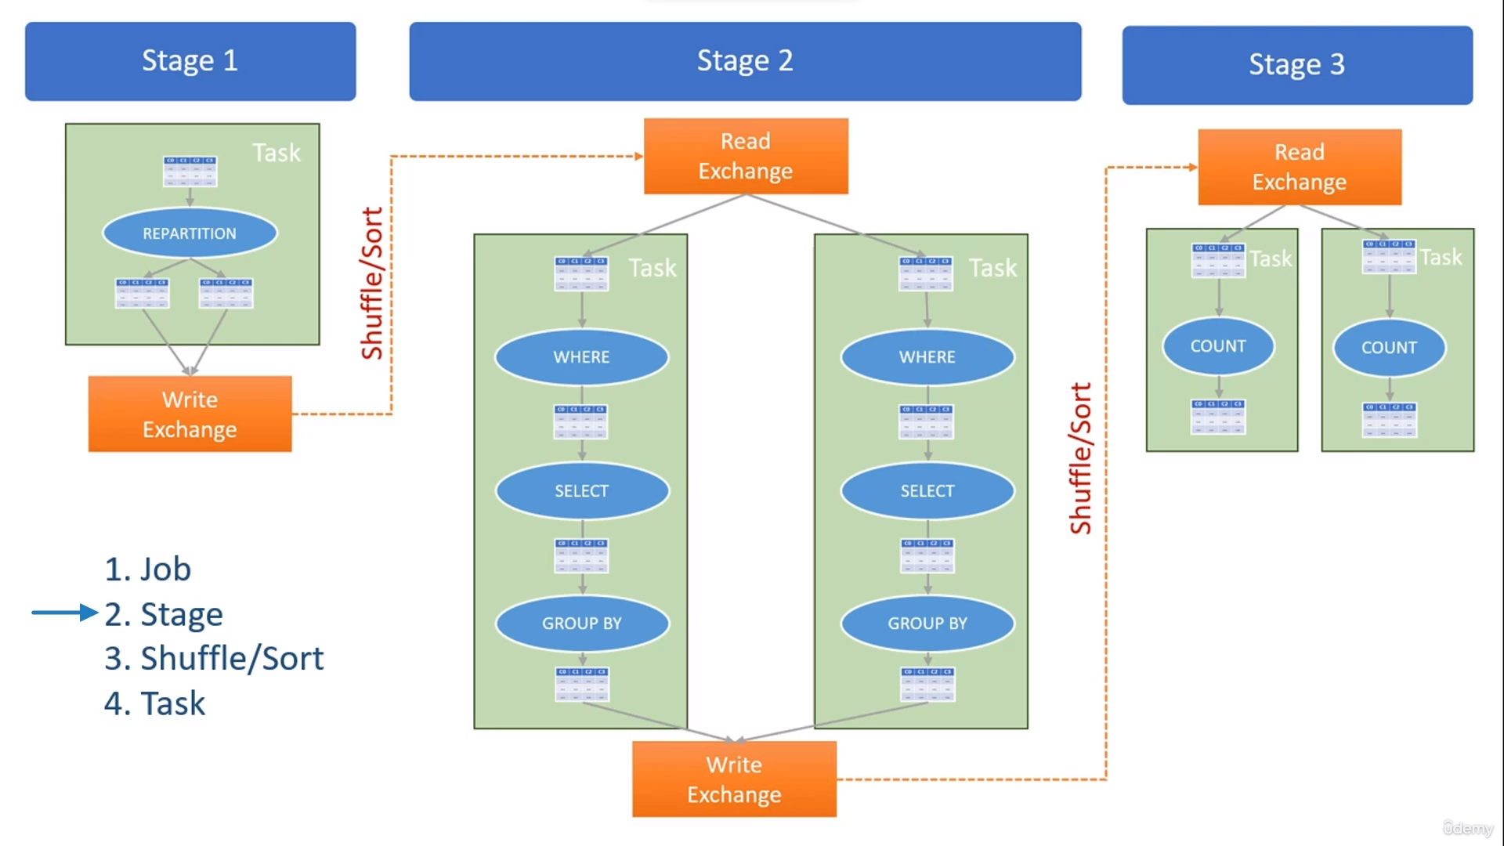

Slide 6
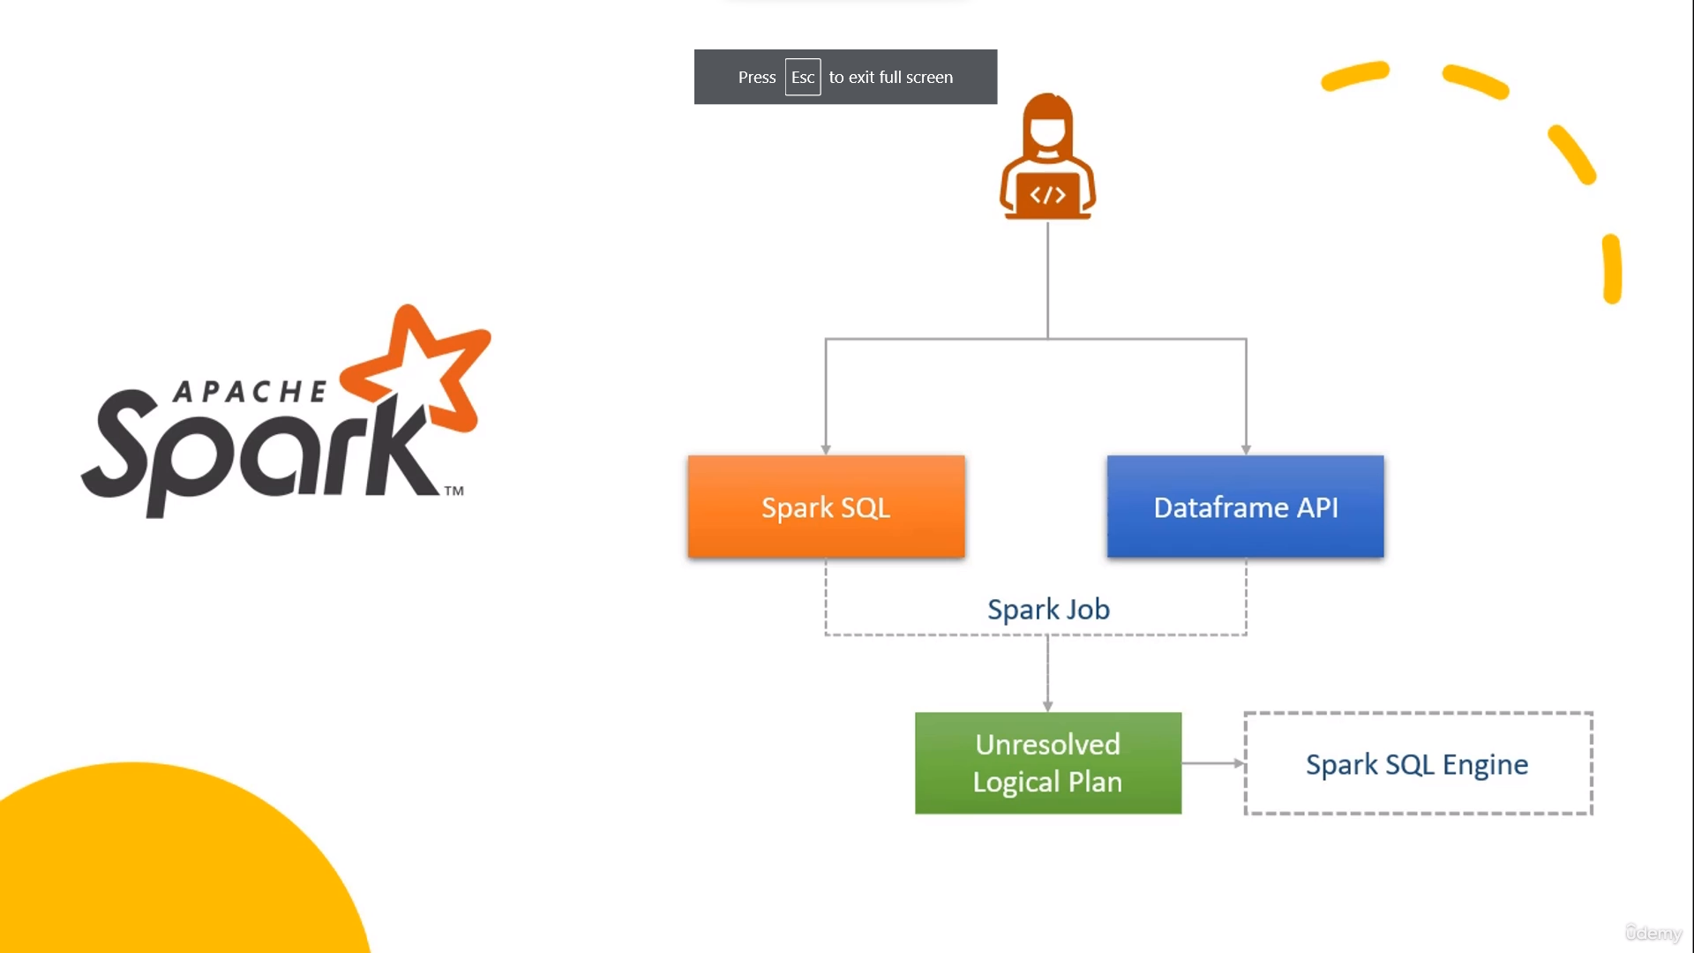

Slide 7
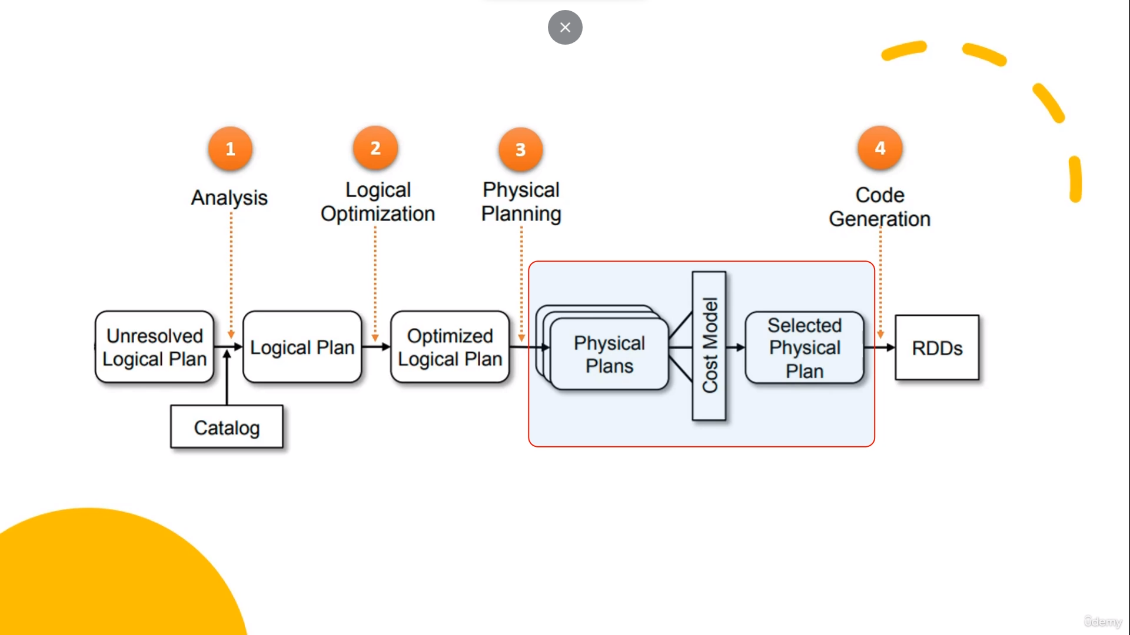

Slide 8
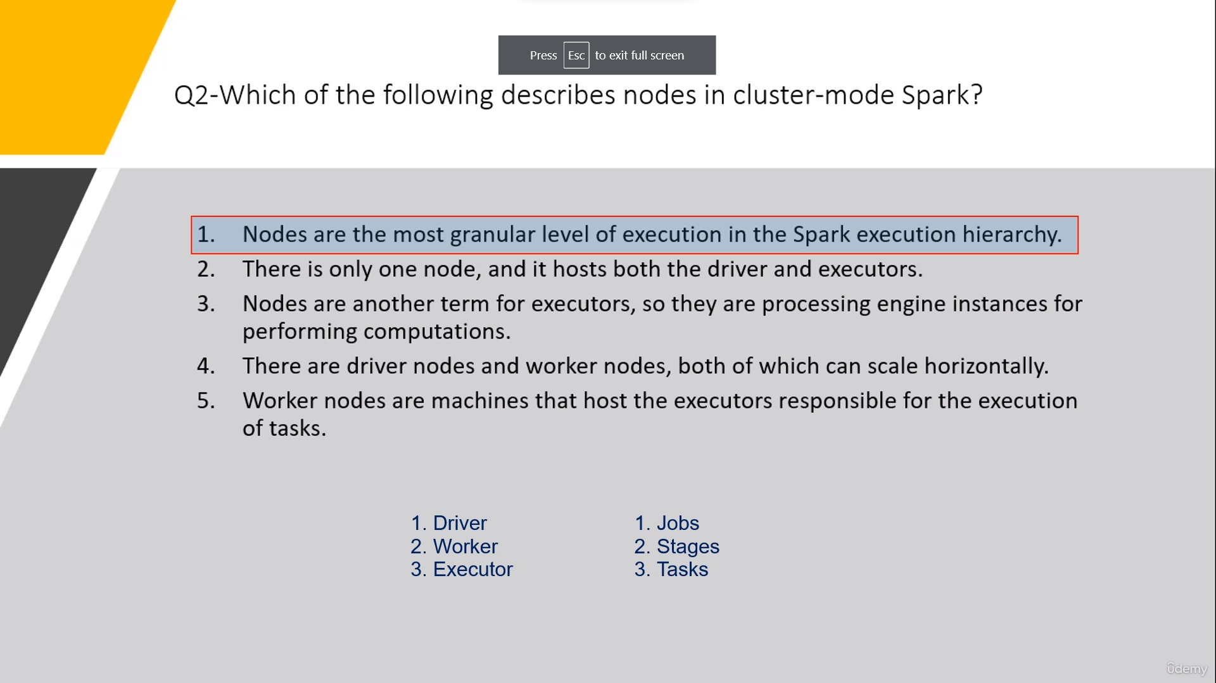

Slide 9
Cluster Components:
Driver: The driver is the heart of a Spark application. It's the process that runs the main() method of your application and is responsible for three main things:
Converting the user program into tasks
Scheduling the tasks on the executors
Managing and monitoring the executors
Worker: In the context of Spark running on a cluster manager, a worker refers to any node that can run application code. In standalone and Mesos modes, worker nodes are specifically the machines on which executors run. In YARN mode, these are called NodeManagers.
Executor: Executors are JVM processes launched for a Spark application on worker nodes. Executors perform the tasks assigned to them by the driver and return the results to the driver. They also store the data that is cached by your application (if any).
Job Execution Breakdown:
Jobs: A job is a parallel computation consisting of multiple tasks that gets spawned in response to a Spark action (like collect, count, save, etc.). For example, if you call an action on an RDD, Spark submits a job to process the data.
Stages: Each job gets divided into smaller sets of tasks called stages that depend on each other (stages are created based on the transformations applied to the RDDs). These are sequences of transformations that can be completed without shuffling the entire dataset.
Tasks: A stage is further divided into tasks, where each task is the smallest unit of work. Each task corresponds to a combination of data and computation. In other words, tasks are the individual units of work that are sent to the executors.
This hierarchy and breakdown is crucial to understanding how Spark manages computation and distributes tasks across the cluster. The driver and executors run the actual computation, while the concept of jobs, stages, and tasks help break down the computational work into manageable units that Spark can efficiently distribute and execute in parallel.

